Slide 1
MIPS ISA
An Introduction

Slide 2
Instruction Set Architecture
Instruction set design objectives
Maximize performance
Minimize cost
Reduce design time

Slide 3
MIPS ISA
A 32-bits (later 64 bits versions) GPR architecture
Developed at Stanford and is a RISC processor
Representative of architectures developed since 1980’s
Used by NEC, Nintendo, Silicon Graphics, Sony
Real architectures but easy to understand
Used successfully in desktops, servers, embedded applications
The name is not related to millions of instructions per second
It stands for Microcomputer without Interlocked Pipeline Stages

Slide 4
MIPS arithmetic
All MIPS arithmetic instructions have 3 operands
Operand order is fixed (destination first)
C code MIPS code
A = B + C add $s0, $s1, $s2; (associated with variables by compiler)
Simplicity favors regularity: Instructions are regular which make simple hardware… And Simpler hardware reduces design time and manufacturing cost.
Expressions need to be broken
C code MIPS code
A = B + C + D add $t0, $s1, $s2
add $s0, $t0, $s3
E = F – A sub $s4, $s5, $s0

Slide 5
Instruction Length And Format
Variable-length instructions(Intel 80x86, VAX):
Require multi-step fetch and decode
But allow a much more flexible and compact instruction set
Fixed-length instructions:
Allow easy fetch and decode
E.g. All MIPS instructions are 32 bits long
On the other side:
Having many different instruction formats implies
Complicates decoding
Use of instruction bits (to specify the format)

Slide 6
Memory Organization
Viewed as a large, single-dimension array, with an address
A memory address is an index into the array
"Byte addressing" means that the index points to a byte of memory
0
1
2
3
4
5
8 bits of data
8 bits of data
8 bits of data
8 bits of data
8 bits of data
8 bits of data

Slide 7
MIPS: Memory Organization
Bytes are nice, but most data items use larger "words”
For MIPS, a word is of 32 bits or 4 bytes
0
4
8
.
.
.
32 bits of data
32 bits of data
32 bits of data
32 bits of data
32 bits of data
32 bits of data
Registers hold 32 bits of data

Slide 8
Load/Store Instructions
MIPS
loading words but addressing bytes
arithmetic on registers only
Instruction Meaning add $s1, $s2, $s3 $s1 = $s2 + $s3 sub $s1, $s2, $s3 $s1 = $s2 – $s3 lw $s1, 100($s2) $s1 = Memory[$s2+100] sw $s1, 100($s2) Memory[$s2+100]= $s1

Slide 9
Load/Store Instructions
To Load and store instructions
Example: C code: A[8] = h + A[8];
MIPS code (load): lw $t0, 32($s3) (arithmetic): add $t0, $s2, $t0 (store): sw $t0, 32($s3)
Load word has destination first, store has destination last
Remember MIPS arithmetic operands are registers, not memory locations
therefore, words must first be moved from memory to registers using loads before they can be operated on; then result can be stored back to memory

Slide 10
MIPS Instruction Formats

Slide 11
MIPS Instruction Formats
All MIPS instructions, like registers and data words, are 32 bits long.
There exist 3 different MIPS instruction formats:
R-type
I-type
J-type
31
26
21
16
11
6
0
op
rs
rt
rd
shamt
funct
6 bits
5 bits
5 bits
5 bits
5 bits
6 bits
31
26
21
16
0
op
rs
rt
immediate
6 bits
5 bits
5 bits
16 bits
31
26
0
op
target address
6 bits
26 bits

Slide 12
R-type
aRithmatic Instruction type
Example: add $t0, $s1, $s2
registers are numbered. For e.g., Here in the below figure:
$t0 is 8, $s1 is 17, $s2 is 18
000000
10001
10010
01000
00000
100000
op rs rt rd shamt funct
6 bits 5 bits 5 bits 5 bits 5 bits 6 bits
opcode –
operation
first
register
source
operand
second
register
source
operand
register
destination
operand
shift
amount
function field -selects variant
of operation

Slide 13
I-type
I-type (“I” for Immediate) for data transfer instructions
Example: lw $t0, 1002($s2) 100011 10010 01000 0000001111101010
op rs rt 16 bit offset
6 bits 5 bits 5 bits 16 bits

Slide 14
Accessing the Operands
Operands are generally in one of two places:
Registers (32, of 32 bits each in MIPS)
Memory (2³² locations)
Registers are
easy to specify
close to the processor (fast access)
Notes:
232

Slide 15
Addressing Modes
How do we specify the operand we want?
Register direct R3
Immediate #25
Direct (absolute) M[10000]
Register indirect M[R3]
Base + Displacement M[R3 + 10000]
Note: if register is the program counter, this is PC-relative
Base + Index M[R3 + R4]
Scaled Index M[R3 + R4*d + 10000]
Auto-increment M[R3++]
Auto-decrement M[R3 --]
Memory Indirect M[ M[R3] ]

Slide 16
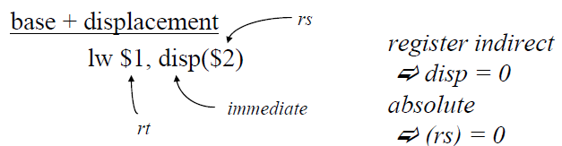
MIPS addressing modes
Register direct
31
26
21
16
11
6
0
add $1, $2, $3
op
rs
rt
rd
shamt
funct
6 bits
5 bits
5 bits
5 bits
5 bits
6 bits
Immediate
31
26
21
16
0
add $1, $2, #35
op
rs
rt
immediate
6 bits
5 bits
5 bits
16 bits

Slide 17
Is this sufficient?
Measurements on the VAX computer show that these addressing modes (immediate, direct, register indirect, and base + displacement) represent 88% of all addressing mode usage.
Similar measurements show that 16 bits is enough for the immediate 75 to 80% of the time
Also, 16 bits is enough of a displacement 99% of the time

Slide 18
The MIPS ISA, so far..
Fixed 32-bit instructions
3 instruction formats
3-operand, load-store architecture
32 general-purpose registers (integer, floating point)
Register zero ($0 or $zero) always has the value 0 and cannot be changed
Registers are 32-bits wide (word)
Register, immediate, and base + displacement addressing modes

Slide 19
Instructions
Arithmetic
Logical
Data transfer
Conditional branch
Unconditional jump

Slide 20
MIPS Instructions (integer)
Arithmetic
add, subtract, multiply, divide
Logical
and, or, shift left, shift right
Data transfer
load word, store word

Slide 21
Conditional Branch
Decision making instructions
alter the control flow
i.e., change the next instruction to be executed
MIPS conditional branch instructions: bne $t0, $t1, Label beq $t0, $t1, Label
Example: bne $s0, $s1, Label add $s3, $s0, $s1 Label: ....
I-type instructions
000100 01000 01001 0000000000011001
beq $t0, $t1, Label
(offset value: 25 = addr: 100)
word-relative addressing
25 words = 100 bytes;

Slide 22
PC Relative Branch
PC-relative addressing is used for conditional branches in MIPS. The address is the Sum of the PC content and a constant(offset) in the instr.
For branch instructions, the constant field is not an address, but an offset from the current PC (containing next instruction address) to the target address
beq $at, $0, L
add $v1, $v0, $0
add $v1, $v1, $v1
j Somewhere
L: add $v1, $v0, $v0
Since the branch target L is three instructions past the beq, the address field would contain 3. The whole beq instruction would be stored as:
000100 00001 00000 0000000000000011

Slide 23
Conditional Branch
How do we specify the destination of a branch?
Empirical studies of real programs show that most branches go to targets less than 32,767(= 2¹⁵) instructions away
branches are mostly used in loops and conditionals
We can specify a relative address in much fewer bits than an absolute address
beq $1, $2, 100

Slide 24
Addresses in Branch
Instructions:
bne $t4,$t5,Label Next instruction is at Label if $t4 != $t5
beq $t4,$t5,Label Next instruction is at Label if $t4 = $t5
Format:
16 bits is too small a reach in a 2³² address space
Solution: specify a register (as for lw and sw) and add it to offset
use PC (= program counter), called PC-relative addressing, based on principle of locality: most branches are to instructions near current instruction (e.g., loops and if statements)
I
op rs rt 16 bit offset

Slide 25
Addresses in Branch
Further extend reach of branch by observing all MIPS instructions are a word (= 4 bytes), therefore word-relative addressing:
MIPS branch destination address = (PC + 4) + (4 * offset)
So offset = (branch destination address – PC – 4)/4
but SPIM does offset = (branch destination address – PC)/4
Because hardware typically increments PC early in execute cycle to point to next instruction

Slide 26
MIPS Conditional Branches
beq, bne, slt
beq r1, r2, addr
slt $1, $2, $3
Set on Less Than (slt)
slt dst,src1,src2
Stores 1 in dst if value in src1 < value in src2 and stores 0 in dst otherwise
These, combined with $0, can implement all fundamental branch conditions
Always, never, !=, = =, >, <=, >=, <, >(unsigned), <= (unsigned), ...

Slide 27
J-type (“J” for Jump) instruction format
Need to be able to:
jump to an absolute address sometime
do procedure calls and returns
Jump:
j 10000
Remember: The jump instruction contains a word address, not an offset
Jump and link: jal 100000
used for procedure calls
Jump register: jr $31
used for returns, can be useful for other things also
OP | Target

Slide 28
Branch Vs. Jump Addressing Modes
Branch uses PC-relative addressing mode
i.e., base + displacement mode, with the PC being the base
Example: If opcode is 6 bits, how many bits are available for displacement? How far can you jump?
Jump uses pseudo-direct addressing mode. 26 bits of the address is in the instruction, the rest is taken from the PC
6 | 26
Instr
4 | 26
PC
jump destination address
 |  | 00

Slide 29
Constants
Small constants are used quite frequently (50% of operands) e.g., A = A + 5; B = B + 1; C = C - 18;
Solutions? Will these work?
create hard-wired registers (like $zero) for constants like 1
put program constants in memory and load them as required
MIPS Instructions: addi $29, $29, 4 slti $8, $18, 10 andi $29, $29, 6 ori $29, $29, 4
How to make this work?

Slide 30
Immediate Operands
Make operand part of instruction itself!
Design Principle: Make the common case fast
Example: addi $sp, $sp, 4 # $sp = $sp + 4
001000
11101
11101
0000000000000100
6 bits 5 bits 5 bits 16 bits
op
rs
rt
16 bit number

Slide 31
How about larger constants?
First we need to load a 32 bit constant into a register
Must use two instructions for this: first new load upper immediate instruction for upper 16 bits lui $t0, 1010101010101010
Then get lower 16 bits in place: ori $t0, $t0, 1010101010101010
Now the constant is in place, use register-register arithmetic
filled with zeros
1010101010101010
0000000000000000
1010101010101010
0000000000000000
0000000000000000
1010101010101010
ori
1010101010101010
1010101010101010

Slide 32
lui Example
Want: addi $t0,$t0,0xABABCDCD
This is a pseudo-instruction!
Translates into:
lui $at,0xABAB # upper 16 ori $at,$at,0xCDCD # lower 16 add $t0,$t0,$at # move
Now we can handle everything with a 16-bit immediate!
Only the assembler gets to use $at

Slide 33
So far
Instruction Format Meaning add $s1,$s2,$s3 R $s1 = $s2 + $s3 sub $s1,$s2,$s3 R $s1 = $s2 – $s3 lw $s1,100($s2) I $s1 = Memory[$s2+100] sw $s1,100($s2) I Memory[$s2+100] = $s1 bne $s4,$s5,Lab1 I Next instr. is at Lab1 if $s4 != $s5 beq $s4,$s5,Lab2 I Next instr. is at Lab2 if $s4 = $s5 j Lab3 J Next instr. is at Lab3
Formats:
R
I
J
op rs rt rd shamt funct
op rs rt 16 bit address
op 26 bit address

Slide 34
Control Flow
We have: beq, bne. What about branch-if-less-than?
New instruction: if $s1 < $s2 then $t0 = 1 slt $t0, $s1, $s2 else $t0 = 0
Can use this instruction to build blt $s1, $s2, Label
how? We generate more than one instruction – pseudo-instruction
can now build general control structures
The assembler needs a register to manufacture instructions from pseudo-instructions
There is a convention (not mandatory) for use of registers
Notes:
Board work: Binary Numbers

Slide 35
Policy-of-Use Convention for Registers
Register 1, called $at, is reserved for the assembler; registers 26-27,
called $k0 and $k1 are reserved for the operating system.

Slide 36
Assembly Language vs. Machine Language
Assembly provides convenient symbolic representation
much easier than writing down numbers
regular rules: e.g., destination first
Machine language is the underlying reality
e.g., destination is no longer first
Assembly can provide pseudo-instructions
e.g., move $t0, $t1 exists only in assembly
would be implemented using add $t0, $t1, $zero
When considering performance you should count actual number of machine instructions that will execute

Slide 37
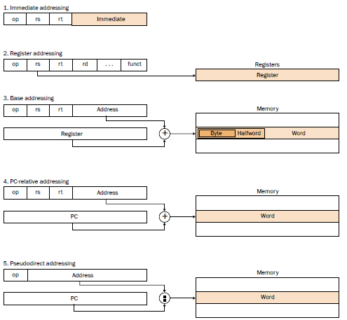
Addressing Modes, Data and Control Transfer

Slide 38
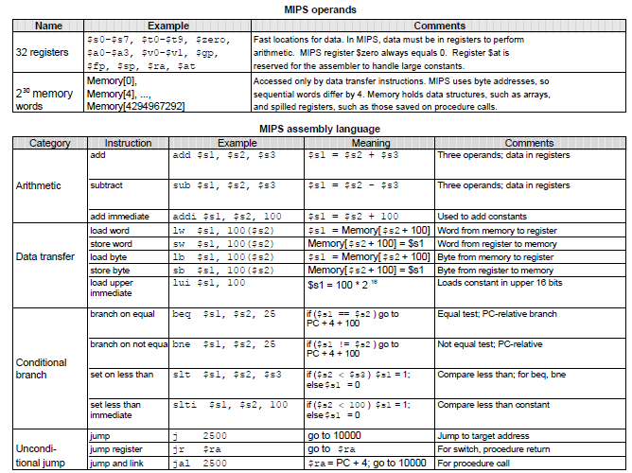
To Summarize:

Slide 39
What If:
64 registers??
20-bit immediates??
4 operand instruction (e.g. Y = AX + B)??

